Slide 1
COMPLETE
BUSINESS
STATISTICS
by
AMIR D. ACZEL
&
JAYAVEL SOUNDERPANDIAN
7th edition.
Prepared by Lloyd Jaisingh, Morehead State University
Chapter 2
Probability
McGraw-Hill/Irwin
Copyright © 2009 by The McGraw-Hill Companies, Inc. All rights reserved.

Slide 2
_{2-<number>}
Probability
2
Using Statistics
Basic Definitions: Events, Sample Space, and Probabilities
Basic Rules for Probability
Conditional Probability
Independence of Events
Combinatorial Concepts
The Law of Total Probability and Bayes’ Theorem
The Joint Probability Table
Using the Computer

Slide 3
LEARNING OBJECTIVES
_{2-<number>}
2
After studying this chapter, you should be able to:
Define probability, sample space, and event.
Distinguish between subjective and objective probability.
Describe the complement of an event, the intersection, and the union of two events.
Compute probabilities of various types of events.
Explain the concept of conditional probability and how to compute it.
Describe permutation and combination and their use in certain probability computations.
Explain Bayes’ theorem and its applications.

Slide 4
2-1 Probability is:
_{2-<number>}
A quantitative measure of uncertainty
A measure of the strength of belief in the occurrence of an uncertain event
A measure of the degree of chance or likelihood of occurrence of an uncertain event
Measured by a number between 0 and 1 (or between 0% and 100%)

Slide 5
Types of Probability
_{2-<number>}
Objective or Classical Probability
  based on equally-likely events
  based on long-run relative frequency of events
  not based on personal beliefs
  is the same for all observers (objective)
  examples: toss a coin, roll a die, pick a card

Slide 6
Types of Probability (Continued)
_{2-<number>}
Subjective Probability
  based on personal beliefs, experiences, prejudices, intuition - personal judgment
  different for all observers (subjective)
  examples: Super Bowl, elections, new product introduction, snowfall

Slide 7
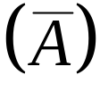
2-2 Basic Definitions
_{2-<number>}
Set - a collection of elements or objects of interest
  Empty set (denoted by ∅)
    a set containing no elements
  Universal set (denoted by S)
    a set containing all possible elements
  Complement (Not). The complement of A is
    a set containing all elements of S not in A

Slide 8

Complement of a Set
_{2-<number>}
S
A
Venn Diagram illustrating the Complement of an event

Slide 9


Basic Definitions (Continued)
_{2-<number>}
  Intersection (And)
    a set containing all elements in both A and B
  Union (Or)
    a set containing all elements in A or B or both

Slide 10


Sets: A Intersecting with B
_{2-<number>}
S
A
B

Slide 11


Sets: A Union B
_{2-<number>}
S
A
B

Slide 12
Basic Definitions (Continued)
_{2-<number>}
  Mutually exclusive or disjoint sets
    sets having no elements in common, having no intersection, whose intersection is the empty set
  Partition
    a collection of mutually exclusive sets which together include all possible elements, whose union is the universal set

Slide 13

Mutually Exclusive or Disjoint Sets
_{2-<number>}
Sets have nothing in common
S
B
A

Slide 14

Sets: Partition
_{2-<number>}
S
A3
A1
A2
A4
A5

Slide 15
Experiment
_{2-<number>}
Process that leads to one of several possible outcomes *, e.g.:
    Coin toss
      Heads, Tails
    Rolling a die
      1, 2, 3, 4, 5, 6
    Pick a card
      AH, KH, QH, ...
    Introduce a new product
Each trial of an experiment has a single observed outcome.
The precise outcome of a random experiment is unknown before a trial.
* Also called a basic outcome, elementary event, or simple event

Slide 16
Events : Definition
_{2-<number>}
Sample Space or Event Set
  Set of all possible outcomes (universal set) for a given experiment
    E.g.: Roll a regular six-sided die
      S = {1,2,3,4,5,6}
Event
  Collection of outcomes having a common characteristic
    E.g.: Even number
      A = {2,4,6}
  Event A occurs if an outcome in the set A occurs
Probability of an event
  Sum of the probabilities of the outcomes of which it consists
    P(A) = P(2) + P(4) + P(6)

Slide 17
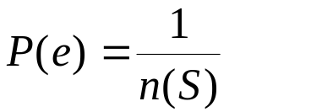
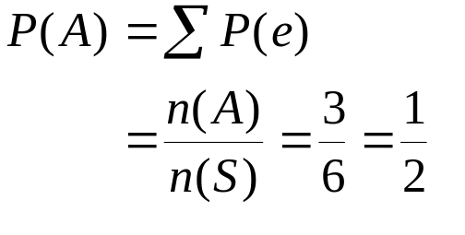
Equally-likely Probabilities
(Hypothetical or Ideal Experiments)
_{2-<number>}
For example:
  Roll a die
    Six possible outcomes {1,2,3,4,5,6}
    If each is equally-likely, the probability of each is 1/6 = 0.1667 = 16.67%
    Probability of each equally-likely outcome is 1 divided by the number of possible outcomes
  Event A (even number)
    P(A) = P(2) + P(4) + P(6) = 1/6 + 1/6 + 1/6 = 1/2
    for e in A

Slide 18
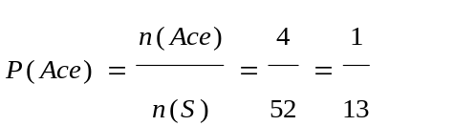
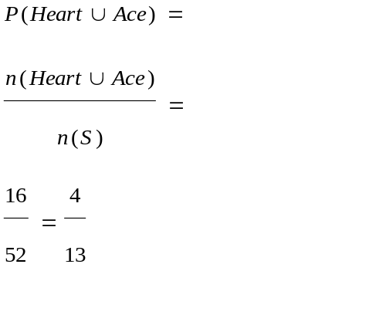
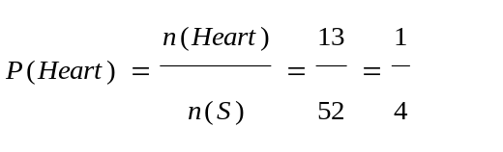
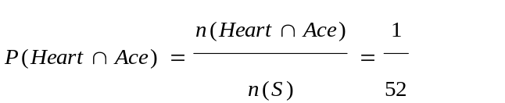
Pick a Card: Sample Space
_{2-<number>}
Hearts
Diamonds
Clubs
Spades
Union of
Events ‘Heart’
and ‘Ace’
A
A
A
A
Event ‘Ace’
K
K
K
K
Q
Q
Q
Q
J
J
J
J
10
10
10
10
9
9
9
9
8
8
8
8
7
7
7
7
6
6
6
6
5
5
5
5
4
4
4
4
3
3
3
3
2
2
2
2
The intersection of the
events ‘Heart’ and ‘Ace’
comprises the single point
circled twice: the ace of hearts
Event ‘Heart’

Slide 19


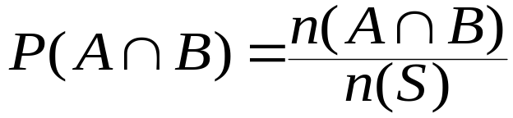

2-3 Basic Rules for Probability
_{2-<number>}
Range of Values for P(A):
Complements - Probability of not A
Intersection - Probability of both A and B
  Mutually exclusive events (A and C) :

Slide 20
Basic Rules for Probability (Continued)
_{2-<number>}
Union - Probability of A or B or both (rule of unions)
  Mutually exclusive events: If A and B are mutually exclusive, then

Slide 21

Sets: P(A Union B)
_{2-<number>}
S
A
B

Slide 22
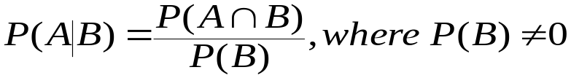
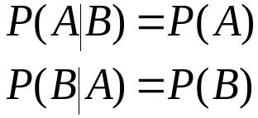
2-4 Conditional Probability
_{2-<number>}
Conditional Probability - Probability of A given B
  Independent events:

Slide 23
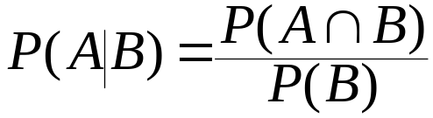
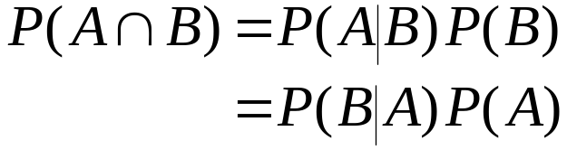
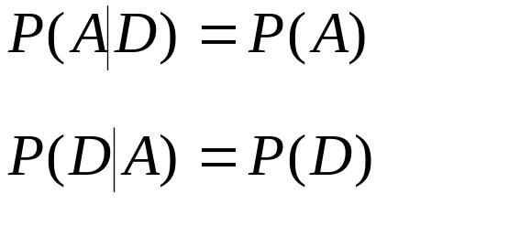

Conditional Probability (continued)
_{2-<number>}
Rules of conditional probability:
so
If events A and D are statistically independent:
so

Slide 24
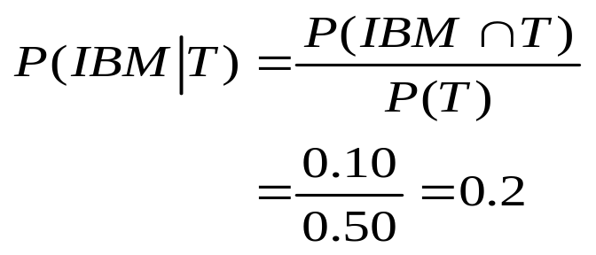
Contingency Table - Example 2-2
_{2-<number>}
Counts
AT& T
IBM
Total
Probability that a project is undertaken by IBM given it is a telecommunications project:
Telecommunication
40
10
50
Computers
20
30
50
Total
60
40
100
Probabilities
AT& T
IBM
Total
Telecommunication
0.40
0.10
0.50
Computers
0.20
0.30
0.50
Total
0.60
0.40
1.00

Slide 25
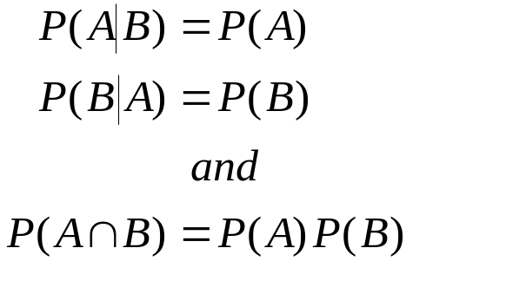
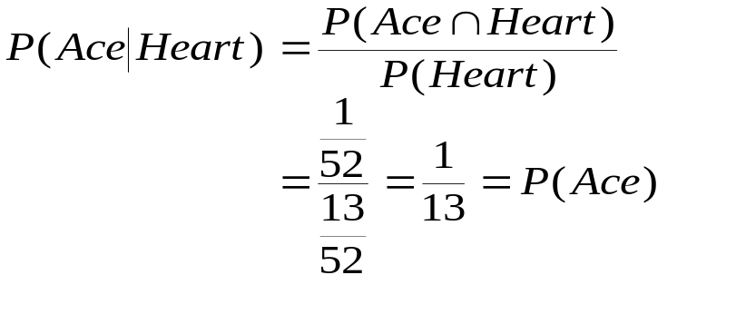
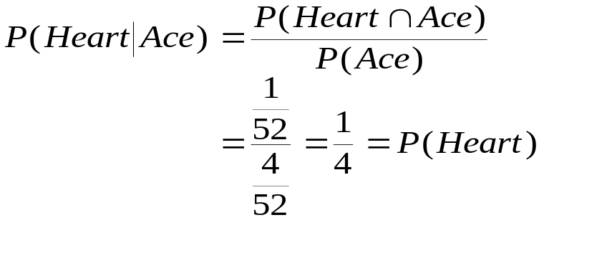
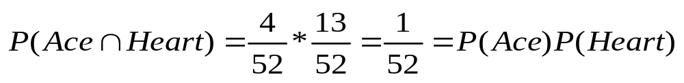
2-5 Independence of Events
_{2-<number>}
Conditions for the statistical independence of events A and B:

Slide 26
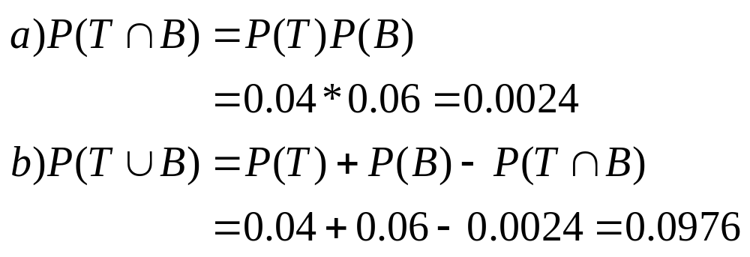
Independence of Events –
Example 2-5
_{2-<number>}
Events Television (T) and Billboard (B) are
assumed to be independent.

Slide 27
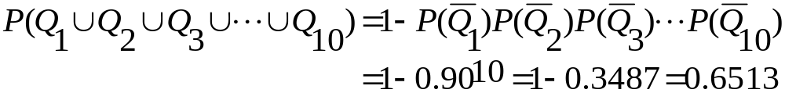
Product Rules for Independent Events
_{2-<number>}
The probability of the intersection of several independent events
is the product of their separate individual probabilities:
The probability of the union of several independent events
is 1 minus the product of probabilities of their complements:
Example 2-7:

Slide 28
2-6 Combinatorial Concepts
_{2-<number>}
Consider a pair of six-sided dice. There are six possible outcomes
from throwing the first die {1,2,3,4,5,6} and six possible outcomes
from throwing the second die {1,2,3,4,5,6}. Altogether, there are
6*6 = 36 possible outcomes from throwing the two dice.
In general, if there are n events and the event i can happen in
N_{i} possible ways, then the number of ways in which the
sequence of n events may occur is N₁N₂...N_{n}.
Pick 5 cards from a deck of 52 - with replacement
  52*52*52*52*52=52⁵ 380,204,032 different possible outcomes
Pick 5 cards from a deck of 52 - without replacement
  52*51*50*49*48 = 311,875,200 different possible outcomes

Slide 29
More on Combinatorial Concepts
(Tree Diagram)
_{2-<number>}
.
.
Order the letters: A, B, and C
.
.
C
.
ABC
B
.
.
.
.
C
B
.
.
ACB
A
A
C
B
.
.
.
BAC
C
A
C
BCA
.
.
A
B
B
CAB
A
CBA

Slide 30
Factorial
_{2-<number>}
How many ways can you order the 3 letters A, B, and C?
There are 3 choices for the first letter, 2 for the second, and 1 for
the last, so there are 3*2*1 = 6 possible ways to order the three
letters A, B, and C.
How many ways are there to order the 6 letters A, B, C, D, E,
and F? (6*5*4*3*2*1 = 720)
Factorial: For any positive integer n, we define n factorial as:
n(n-1)(n-2)...(1). We denote n factorial as n!.
The number n! is the number of ways in which n objects can
be ordered. By definition 1! = 1 and 0! = 1.

Slide 31
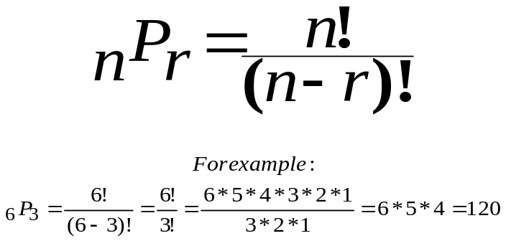
Permutations (Order is important)
_{2-<number>}
What if we chose only 3 out of the 6 letters A, B, C, D, E, and F?
There are 6 ways to choose the first letter, 5 ways to choose the
second letter, and 4 ways to choose the third letter (leaving 3
letters unchosen). That makes 6*5*4=120 possible orderings or
permutations.
Permutations are the possible ordered selections of r objects out
of a total of n objects. The number of permutations of n objects
taken r at a time is denoted by nPr, where

Slide 32

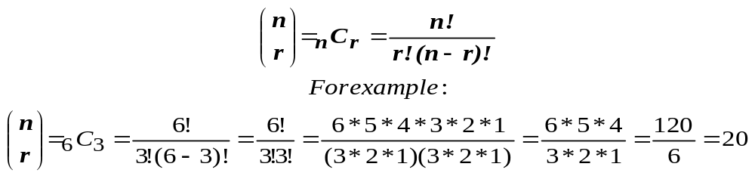
Combinations (Order is not Important)
_{2-<number>}
Suppose that when we pick 3 letters out of the 6 letters A, B, C, D, E, and F
we chose BCD, or BDC, or CBD, or CDB, or DBC, or DCB. (These are the
6 (3!) permutations or orderings of the 3 letters B, C, and D.) But these are
orderings of the same combination of 3 letters. How many combinations of 6
different letters, taking 3 at a time, are there?
Combinations are the possible selections of r items from a group of n items
regardless of the order of selection. The number of combinations is denoted
and is read as n choose r. An alternative notation is nCr. We define the number
of combinations of r out of n elements as:

Slide 33
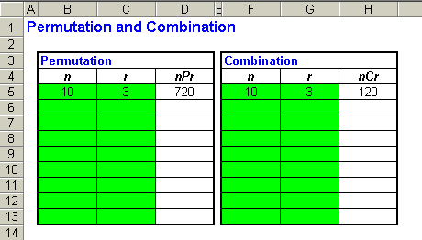
Example: Template for Calculating Permutations & Combinations
_{2-<number>}

Slide 34
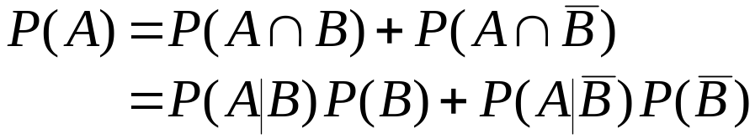
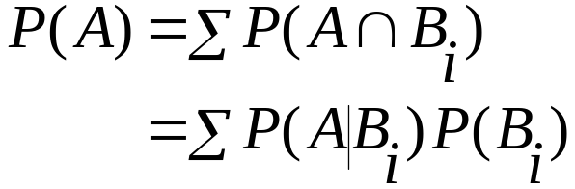
2-7 The Law of Total Probability and Bayes’ Theorem
_{2-<number>}
The law of total probability:
In terms of conditional probabilities:
More generally (where B_{i} make up a partition):

Slide 35
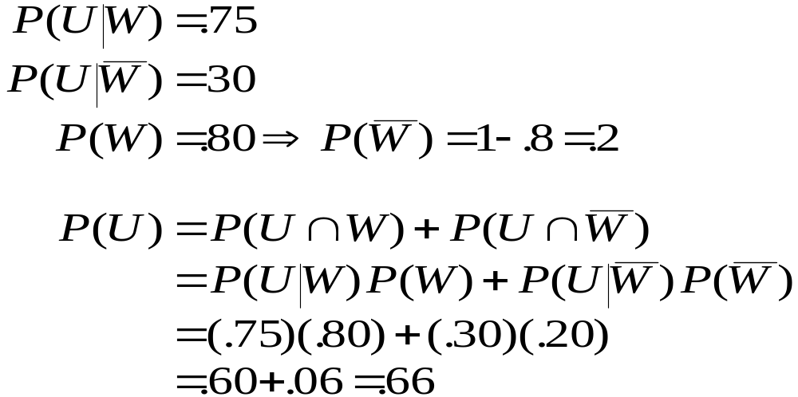
The Law of Total Probability-
Example 2-9
_{2-<number>}
Event U: Stock market will go up in the next year
Event W: Economy will do well in the next year

Slide 36
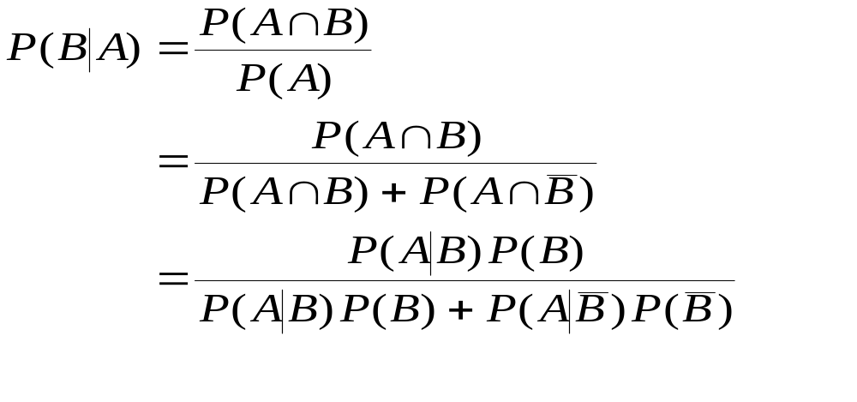
Bayes’ Theorem
_{2-<number>}
Bayes’ theorem enables you, knowing just a little more than the probability of A given B, to find the probability of B given A.
Based on the definition of conditional probability and the law of total probability.
Applying the law of total
probability to the denominator
Applying the definition of
conditional probability throughout

Slide 37
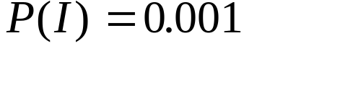




Bayes’ Theorem - Example 2-10
_{2-<number>}
A medical test for a rare disease (affecting 0.1% of the population [ ]) is imperfect:
  When administered to an ill person, the test will indicate so with probability 0.92 [ ]
    The event is a false negative
  When administered to a person who is not ill, the test will erroneously give a positive result (false positive) with probability 0.04 [ ]
    The event is a false positive. .

Slide 38
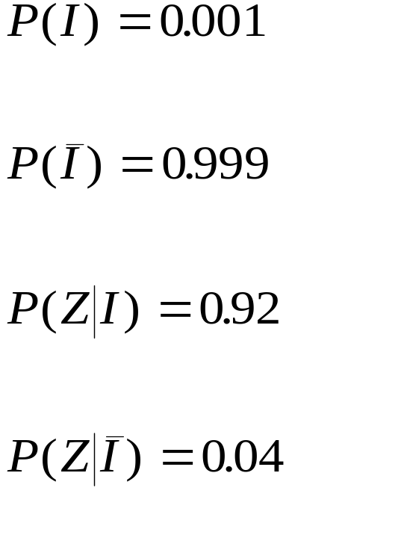
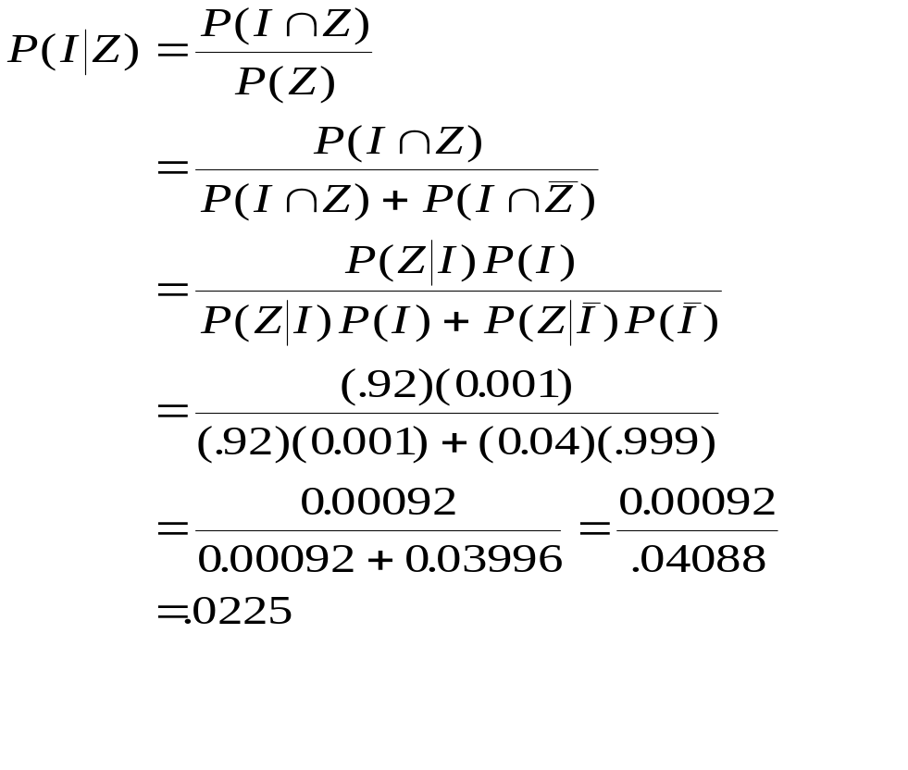
Example 2-10 (continued)
_{2-<number>}

Slide 39









Example 2-10 (Tree Diagram)
_{2-<number>}
Prior
Probabilities
Conditional
Probabilities
Joint
Probabilities

Slide 40
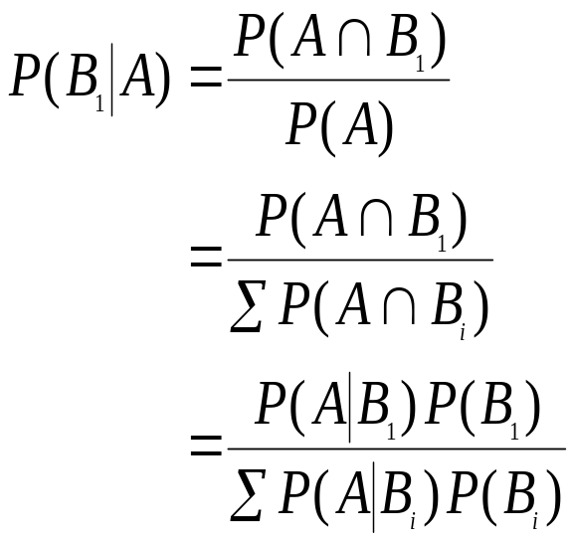
Bayes’ Theorem Extended
_{2-<number>}
Given a partition of events B₁,B₂ ,...,B_{n}:
Applying the law of total
probability to the denominator
Applying the definition of
conditional probability throughout

Slide 41
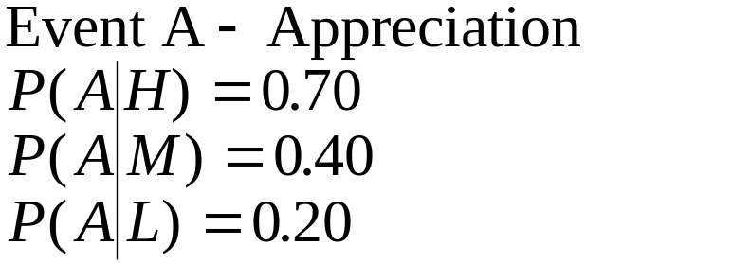
Bayes’ Theorem Extended -
Example 2-11
_{2-<number>}
An economist believes that during periods of high economic growth, the U.S. dollar appreciates with probability 0.70; in periods of moderate economic growth, the dollar appreciates with probability 0.40; and during periods of low economic growth, the dollar appreciates with probability 0.20.
During any period of time, the probability of high economic growth is 0.30, the probability of moderate economic growth is 0.50, and the probability of low economic growth is 0.50.
Suppose the dollar has been appreciating during the present period. What is the probability we are experiencing a period of high economic growth?
Partition:
H - High growth P(H) = 0.30
M - Moderate growth P(M) = 0.50
L - Low growth P(L) = 0.20

Slide 42
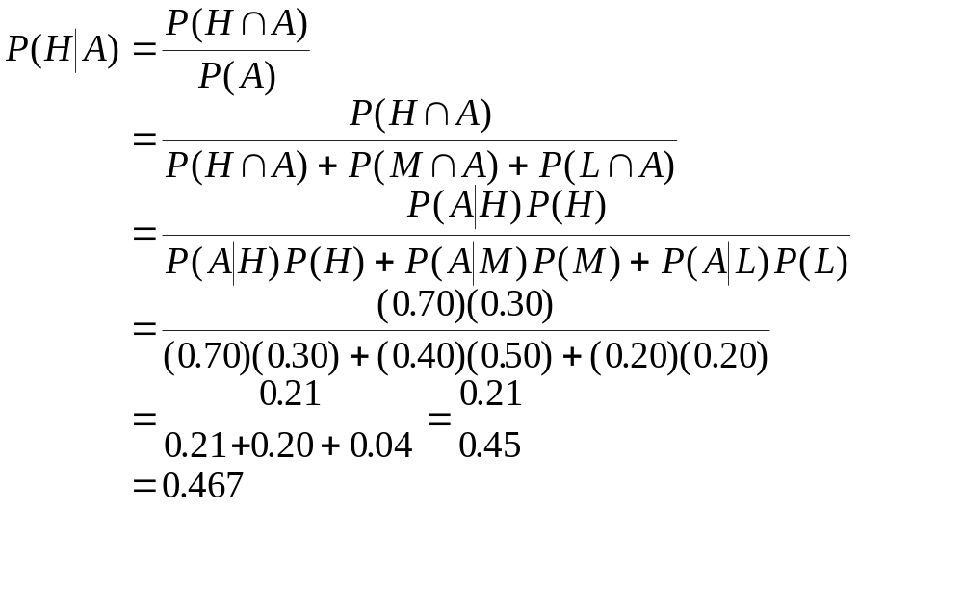
Example 2-11 (continued)
_{2-<number>}

Slide 43

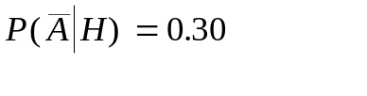








Example 2-11 (Tree Diagram)
_{2-<number>}
Prior
Probabilities
Conditional
Probabilities
Joint
Probabilities

Slide 44
2-8 The Joint Probability Table
_{2-<number>}
A joint probability table is similar to a contingency table , except that it has probabilities in place of frequencies.
The joint probability for Example 2-11 is shown below.
The row totals and column totals are called marginal probabilities.

Slide 45
The Joint Probability Table
_{2-<number>}
A joint probability table is similar to a contingency table , except that it has probabilities in place of frequencies.
The joint probability for Example 2-11 is shown on the next slide.
The row totals and column totals are called marginal probabilities.

Slide 46
The Joint Probability Table:
Example 2-11
_{2-<number>}
The joint probability table for Example 2-11 is summarized below.
 | High | Medium | Low | Total
$ Appreciates | 0.21 | 0.2 | 0.04 | 0.45
$Depreciates | 0.09 | 0.3 | 0.16 | 0.55
Total | 0.30 | 0.5 | 0.20 | 1.00
Marginal probabilities are the row totals and the column totals.

Slide 47
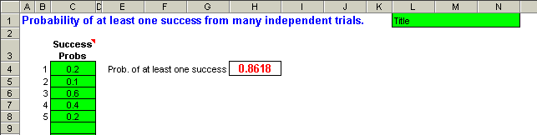
2-8 Using Computer: Template for Calculating the Probability of at least one success
_{2-<number>}

Slide 48
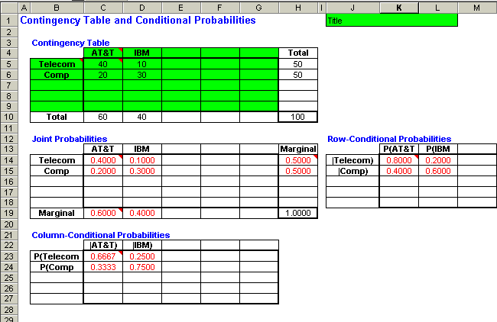
2-8 Using Computer: Template for Calculating the Probabilities from a Contingency
Table-Example 2-11
_{2-<number>}

Slide 49
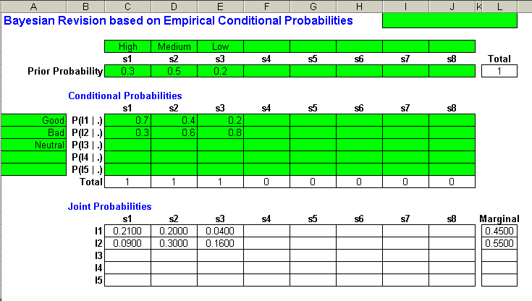
2-8 Using Computer: Template for Bayesian Revision of Probabilities-Example 2-11
_{2-<number>}

Slide 50
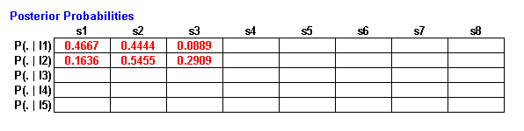
2-8 Using Computer: Template for Bayesian Revision of Probabilities-Example 2-11
_{2-<number>}
Continuation of output from previous slide.

